Slide 1


UNIVERSITÀ DI PADOVA
FACOLTÀ DI MATEMATICA
Business Economics and Financial Data Project
Fuel Prices of Italy (1996-2021)
Gaia Ziraldo
Sercan Albut
18.01.2022

Slide 2
Fuel Prices of Italy (1996-2021): Introduction
This project is focused on the time series analysis of the fuel prices of Italy between 1996 and 2021
The Data includes 4 types of fuel: Euro Super 95 (Benzina), Diesel, Residual Fuel Oil, LPG
The type of time sequence is month and the prices include fix and additive (VAT) tax and also every price corresponds to 1000 Lt of fuel.

Slide 3
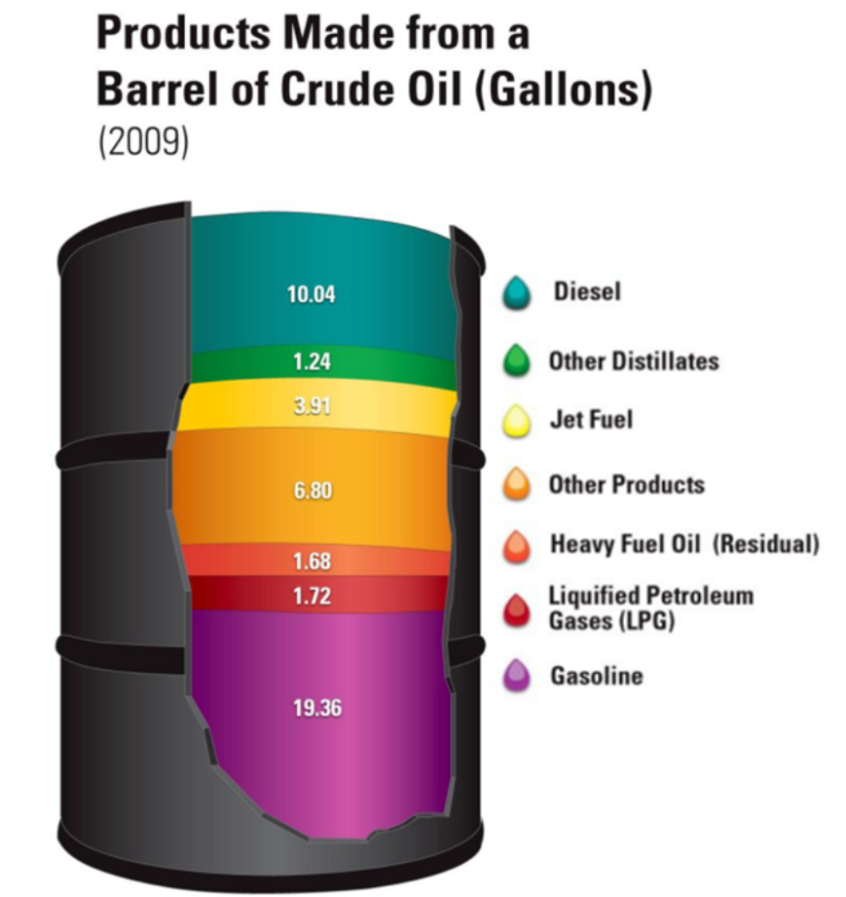
Fuel Prices of Italy (1996-2021): Introduction
Economic spesifications of Fuel:
Life cycle of fuel is not limited at the considered time period.
Fuel prices are sensible to variations in global economy and also to local taxation.
All 4 of the fuels are a side product of Crude Oil

Slide 4
Difference Between Fuels
Euro Super 95 (Benzina): Used for vehicles (Mainly for automobile)
Diesel: Mostly used for machinery with internal combustion engines (ships, agricultural vehicles, cars etc.), a low percantage is used for heating and electricity production.
LPG (Liquified Petroleum Gas): Mostly used for small and medium combustions such as cooking and heating, also used for vehicles.
Residual Fuel Oil: Mainly used as marine fuel.

Slide 5
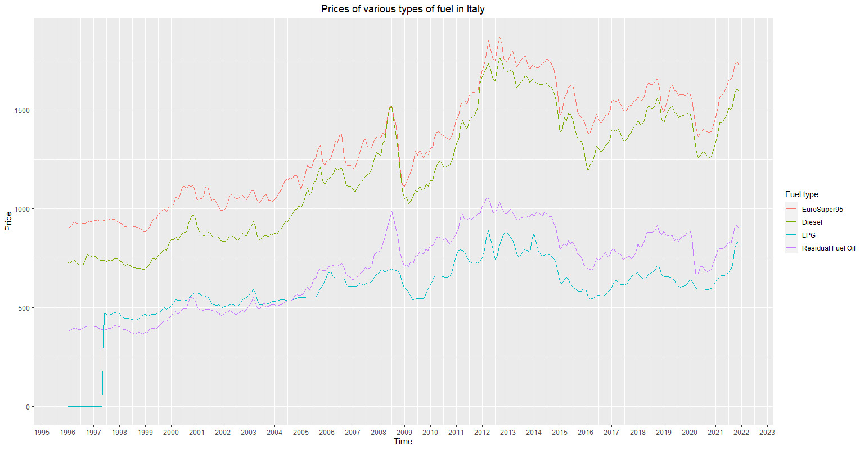
Plot of Fuel Prices

Slide 6
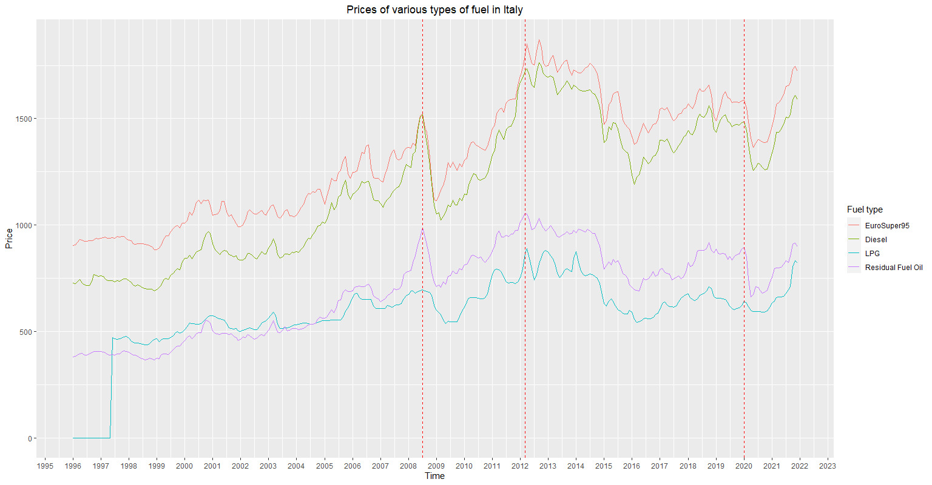
Interpretation of Fuel Prices Graph

Slide 7
Modelling Strategy
The objective of our research was to implement a model to forecast each fuel price individually or in relation with other fuel types.
For starters, each fuel price has been modelled individually. The following models have been implemented for every type of fuel:
BASS (Simple and Generalized) Model
Linear Model with seasonality
ARIMA and SARIMA model
UCRCD and GAM (collective modelling for all the fuel prices)

Slide 8
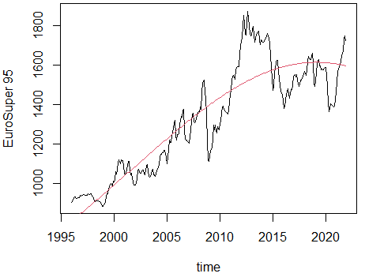
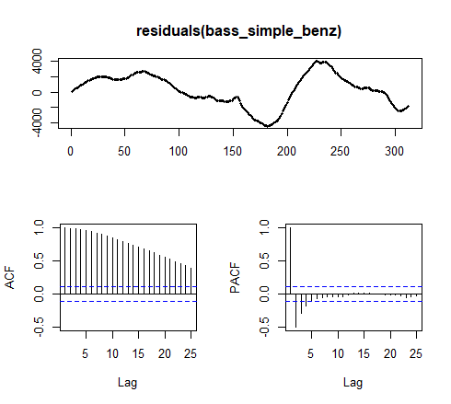
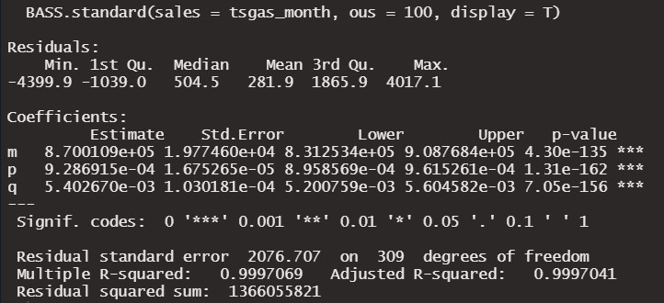
Euro Super 95 - Simple BASS Model
Since Fuel is not a product with a limited life cycle, BASS model was not the most proper model to be applied in this case. However we wanted to check how well it could generalize the data. ACF and PACF indicate that a seasonal behaviour still needs to be considered.

Slide 9
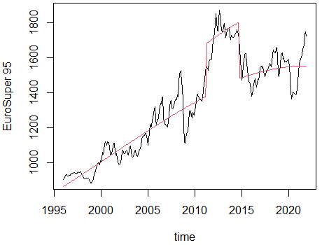
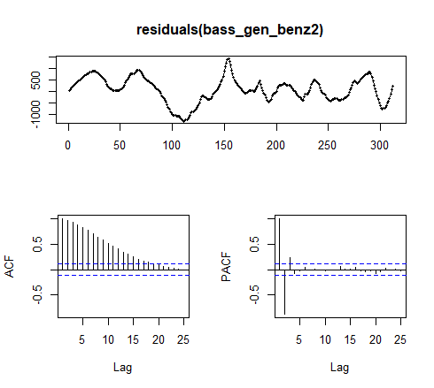
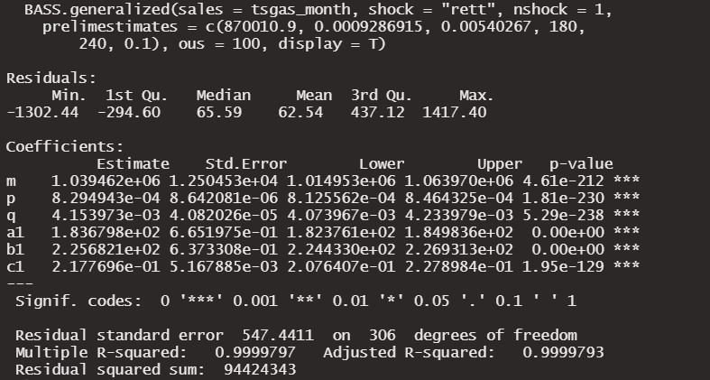
Euro Super 95 - Rectangular Shock
To improve the previous model we tried to capture the shock that occured after 2008 global economical crises.
This model managed to reduce the magnitude of residuals and some of the autocorrelations.

Slide 10
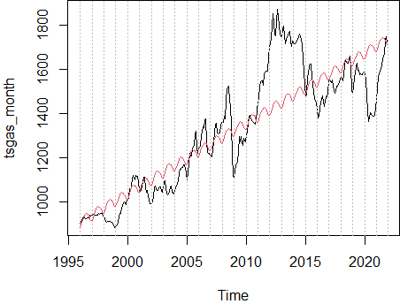
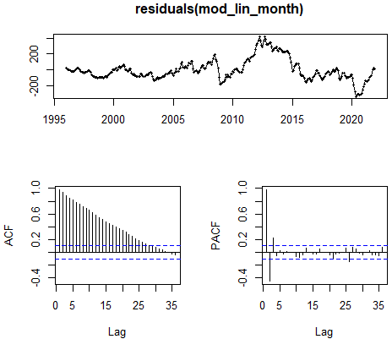
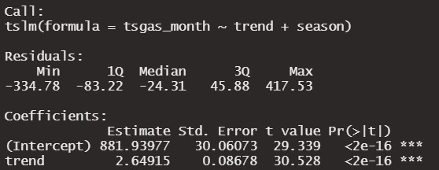
Euro Super 95 – Linear Model
The Linear model, although it was not able to capture the spikes due to economical crisis, it was efficent to point out the trend and the seasonal behaviour of the prices. It can be observed that Euro Super 95 prices are generally higher during summer because there is an increase in mobility.

Slide 11
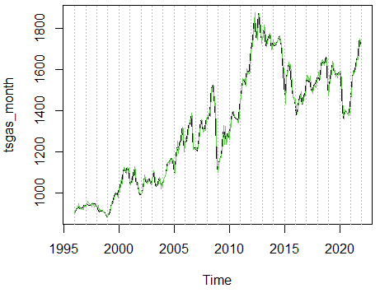
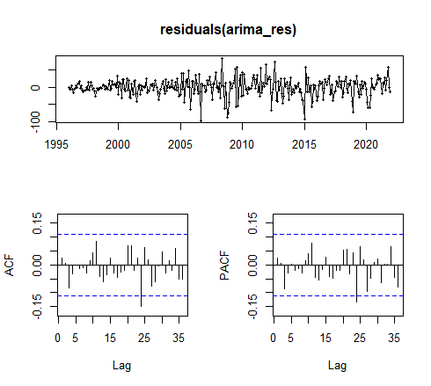
Euro Super 95 – Linear Model + ARIMA Residual
Since residuals of the linear model still presented some structure, we tried to capture their behaviour with an ARIMA Model. The best model selected for the residuals resulted an ARIMA(0,1,1) which provided an improved fit. It can be observed a spike in the ACF at lag 24 which is possibly due to high fluctuations in the data.

Slide 12
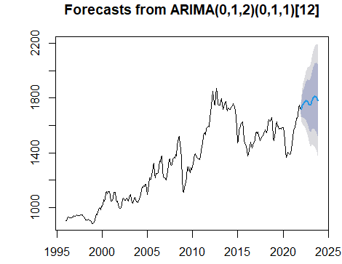
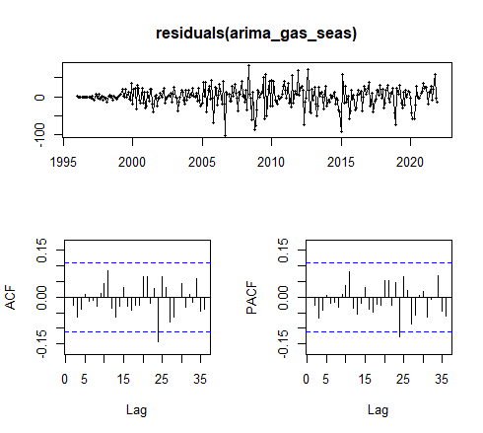
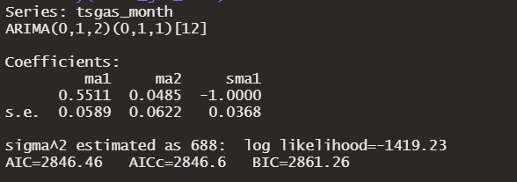
Euro Super 95 - SARIMA
After fitting a variaty of ARIMA models, the one seemed to better capture the structure of the time series resulted with SARIMA(0,1,2)(0,1,1). Such model performed similarly as the linear model with ARIMA residuals. Forecasts indicate that we can expect a steady increase of the fuel prices in Italy.

Slide 13
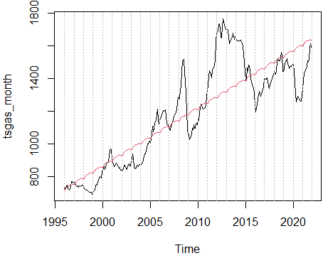

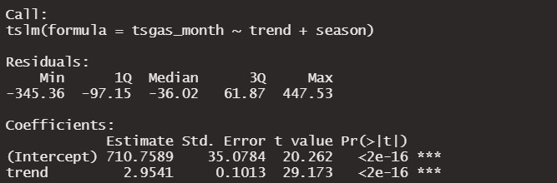
Diesel – Linear Model
For Diesel, all the previously shown models have been applied and plotted. Here we wanted to show if diesel prices have presented a seasonal trendy behaviour. Contrarily to our expectations, the linear model didn’t capture a seasonal behaviour. It is worth noting that 2 different types of diesel fuel are supplied in winter and summer, and there was also an abnormal tax increase for diesel fuel at 2008.

Slide 14
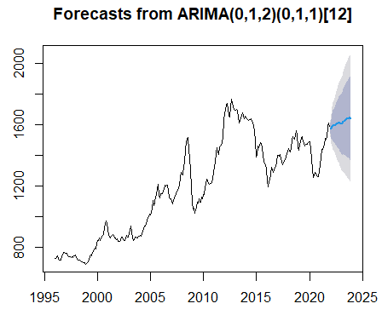
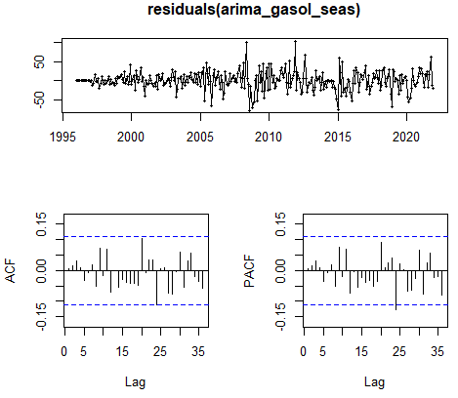
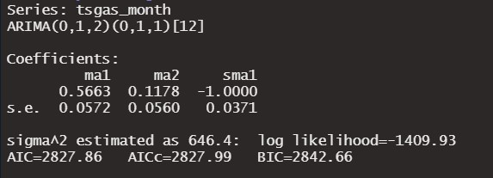
Diesel – SARIMA Model
Similarly as Euro Super 95, the best model was SARIMA (0,1,2)(0,1,1). Such model seems to capture growing trend in the prices. Comparing the AIC levels, SARIMA achived the better fit. No relevant seasonal behaviour was noticed in the time series.

Slide 15
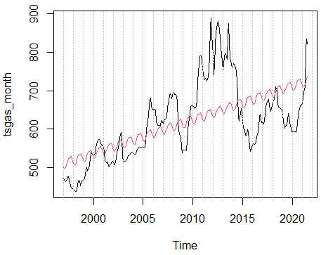
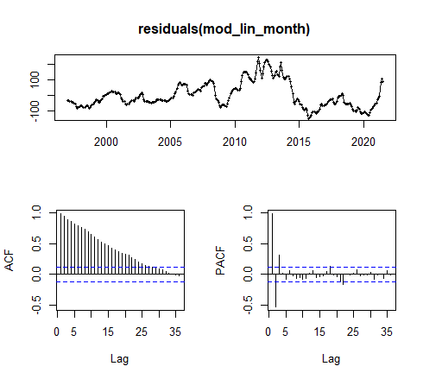
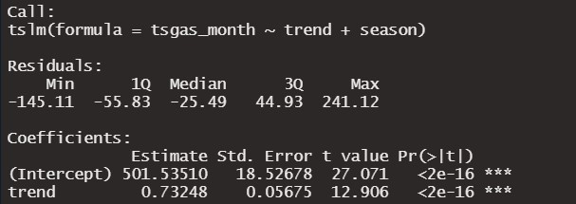
LPG – Linear Model
If we look at the LPG, it is worth considering that since LPG is mostly used for medium combustion and heating, there is an increase in demand during winter. Seasonality can be observed yearly by increase in winter and decrease in summer. In LPG data, first 18 months were missing, that is why top of the seasonal curve corresponds as winter.

Slide 16
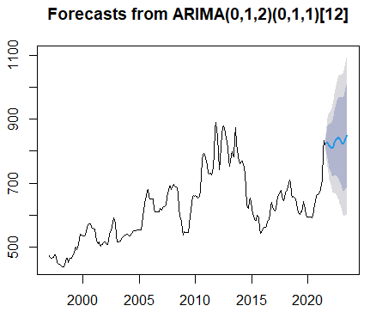
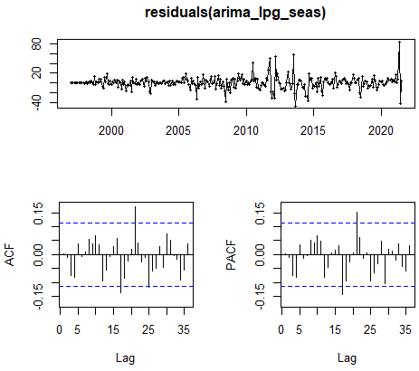
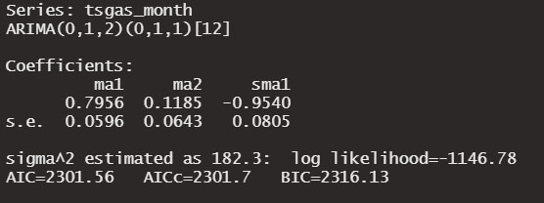
LPG – SARIMA
SARIMA(0,1,2)(0,1,1) was the best model to capture the behaviour of the time series, especially its seasonal structure. However it appears again that there are some lags in ACF, which indicates that there are some relation in the data which still needs to be modelled.

Slide 17
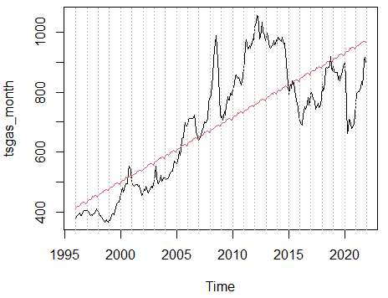
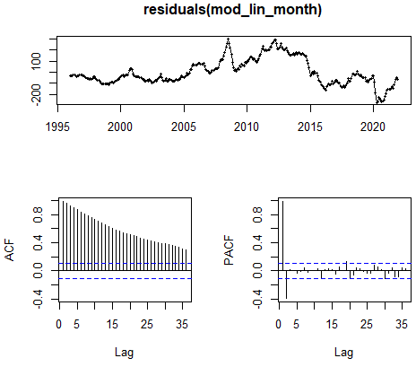
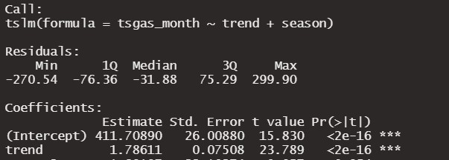
Residual fuel – Linear Model
As you can see for the residual fuel (heavy fuel), same structure is current as previously seen in Diesel. As expected there is not much of a seasonality observed except there is an increasing trend in the price. Due to the usage of this product (used mainly by tranportships by meaning sea fare is less affected by seasons) seasonality is less current.

Slide 18
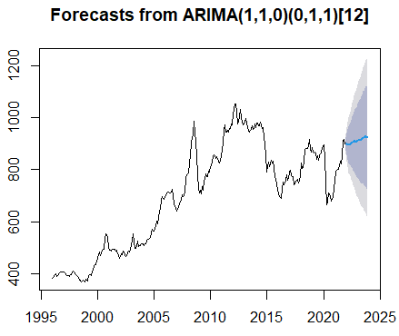
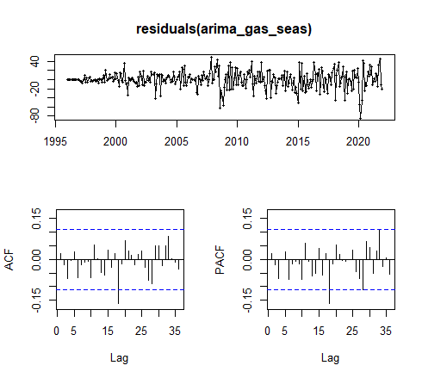
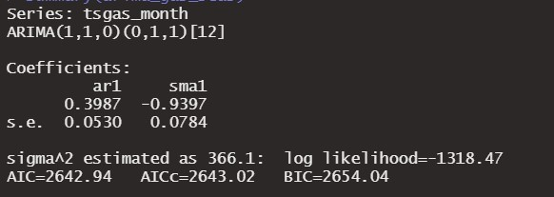
Residual fuel – SARIMA
Even though SARIMA(1,1,0)(0,1,1) is the best fit for this time series, forecast is too wide to be considered significant. The only significant part of the forecast is that it captures the increasing trend.

Slide 19
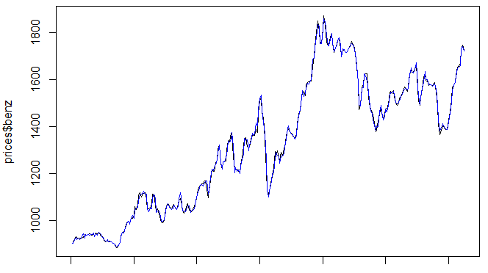
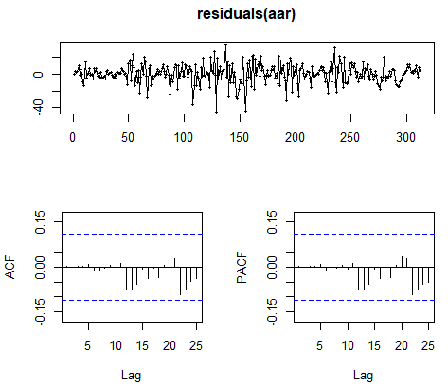
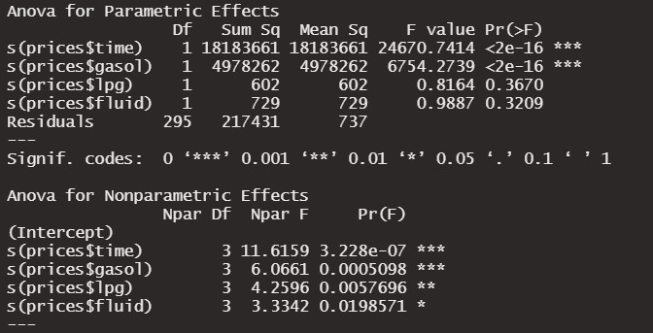
GAM – Euro Super 95
Since we observed a similar behaviour of all the fuel prices, especially in correspondence to crises, we decided to model benzina wtih with respect to other fuel types with GAM. Additionally the residuals were modelled with SARIMA(6,0,6)(3,1,3). Only the price of diesel resulted significant to determine the price of benzina

Slide 20
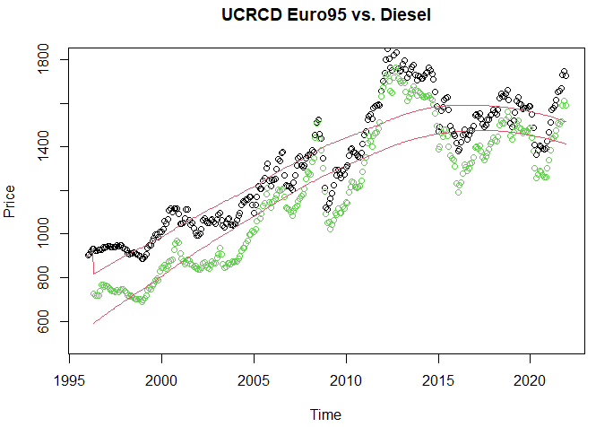
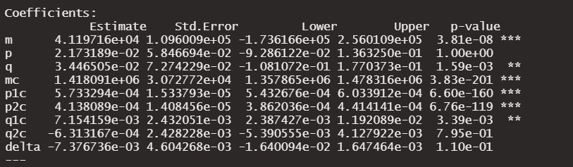
UCRCD Euro Super 95 vs Diesel
We wanted to investigate a possible competition or collaboration regime between types of fuel used for vehicles. We tested a UCRCD model between benzina and diesel.
In this case we decided to use diesel fuel as newly introduced fuel, since diesel fuel engines are introduced to the market later. We set a symbolic small time lag between the two series.
The delta parameter, however, was not significant enough to provide the evidence for a competition between the two fuel types.

Slide 21
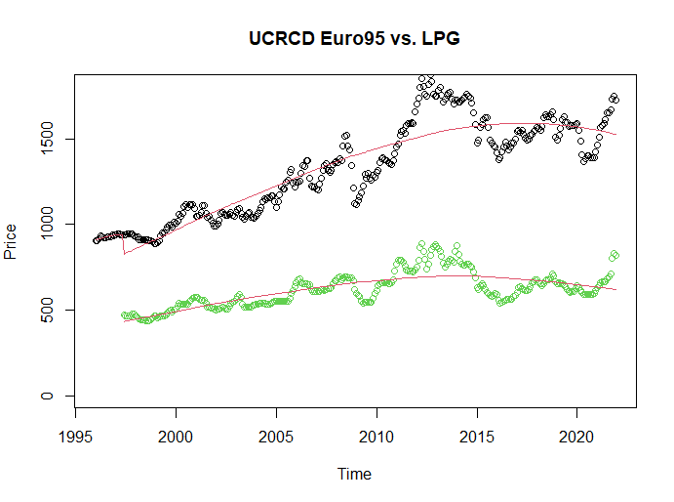
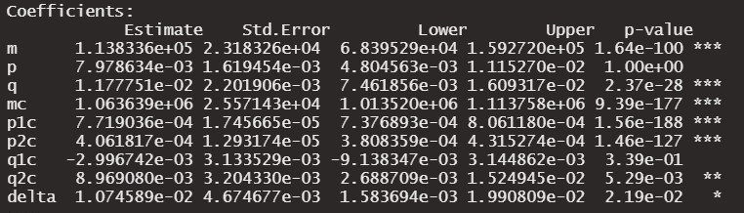
UCRCD Euro Super 95 vs LPG
In 1998, automobile sector introduced a new engine type for cars which started to use LPG. So we wanted to use this introduction as first step of the UCRCD model and test LPG against benzina.
In this case coefficient estimates appeared more significant and indicated a full competition regime between the two products.
However, it is important to keep in consideration that both fuels are not perfectly in competitive fields. They have different fields of usage. This may caused a confounding effect in the model.

Slide 22
Conclusion
Fuel is a product that, at least for this time period, has an unlimited life cycle. It is being used in an extremely wide variety of fields and it is still the predominant source of energy in our society.
All the fuel types we considered showed an increasing price trend in time.
Global economical and social shocks are highly affecting the price of fuels. This volatility is making the prices hard to model and forecast.

Slide 23
THANK YOU FOR YOUR ATTENTION!

